Slide 1
Neurolaw: Criminal Responsibility
By: Emily O’Brian, Elizabeth Pearson, & Naveen Krishnan

Slide 2
Responsibility Exception: defect in rationality
“American law holds people criminally responsible unless they act under duress (with a gun pointed at the head, for example) or if they suffer from a serious defect in rationality — like not being able to tell right from wrong. But if you suffer from such a serious defect, the law generally doesn’t care why — whether it’s an unhappy childhood or an arachnoid cyst or both.”
-New York Times

Slide 3
What is the purpose of law and punishment?

Slide 4
The most prominent questions that have emerged from this exploration are as follows:
o To what extent can a tumor or brain injury alleviate criminal punishment?
o Can sentencing or rehabilitation regulations be influenced by neuroscience?
o Who is permitted access to images of a person’s brain?

Slide 6
How to implement future actions?
Neuroimaging (fMRI)
Brain development
Psychological Illness
Weinstein’s cyst
Juvenile sentencing
Criminal Insanity Defense

Slide 7
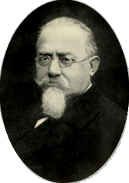
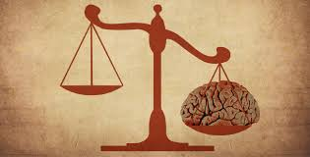
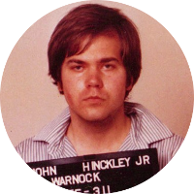
Neurocriminology: A Timeline
19th Cent.: Cesare Lombroso
Mid-20th Cent.: Insanity Plea
1981: John Hinckley
1991: “Neurolaw”
1993: Daubert Standard
2007: Law & Neuroscience Project
Now: ¯\_(ツ)_/¯

Slide 8
CRIMINAL RESPONSIBILITY

Slide 9
“If free will does exist, it has little room in which to operate. It can at best be a small factor riding on top of vast neural networks shaped by genes and environment. In fact, free will may end up being so small that we eventually think about bad decision-making in the same way we think about any physical process, such as diabetes or lung disease.”
David Eagleman
Founder and Director of Center for Science and Law
“Criminal law presupposes free will… Imagine accepting the idea that among us, all the people we see, they’re not all people. Some of them are hurricanes, some of them are inanimate objects. ”
Alan D. Gold
Criminal lawyer
“We are all, in a sense, like hurricanes. [This] doesn’t mean that behavior is not flexible. ”
Joshua Greene
Professor of Psychology at Harvard

Slide 10
PREDICTION & SENTENCING

Slide 11
”Making predictions is not new… you can look at a number of socioeconomic factors and personality factors...and make certainly much much better than chance predictions about who’s likely to be committing crime and who’s not.”
Joshua Greene
Professor of Psychology at Harvard

Slide 12
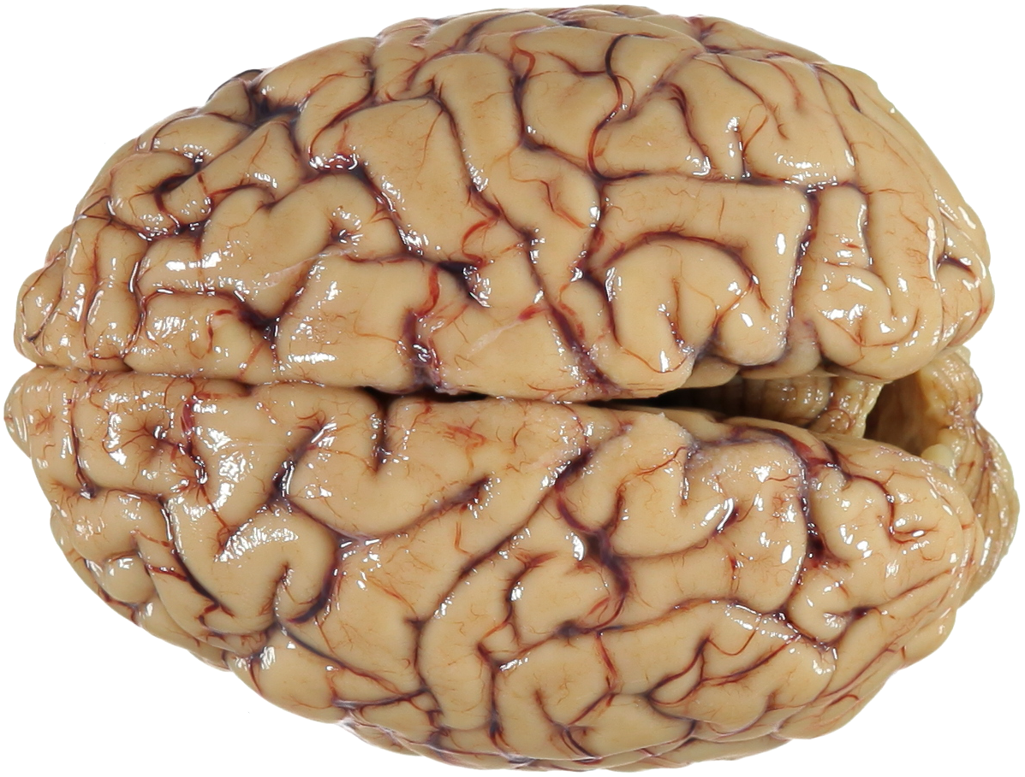
Neurophysiological Studies
Damage by foreign objects
Increase in the volume of the striatum
Underdeveloped Amygdalae
Low number of neurons in the prefrontal cortex
Bigger right hippocampus
Cavum septi pellucidi maldevelopment

Slide 13
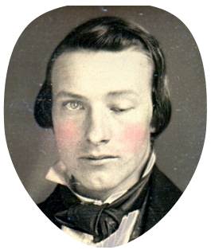
Neurophysiological Studies
Damage by foreign objects
Remember him?

Slide 14
Neurofunctional Studies
Functional Disturbances of the Hippocampus
Higher Activation of Subcortical Limbic Regions
Reduced activity in the amygdala
Lack of activation in the prefrontal cortex
Reduced Cerebral Blood Flow in Angular Gyrus
Dysfunctional Posterior Cingulate

Slide 15
Neurophysiological Studies
Think Joe from the Ted Talk!
“Our research does not suggest that criminals should submit their MRI scans as evidence in court and get off the hook because they’ve got a faulty amygdala”
Daniel Reisel
Rewiring Our Morality
Reduced activity in the amygdala

Slide 16
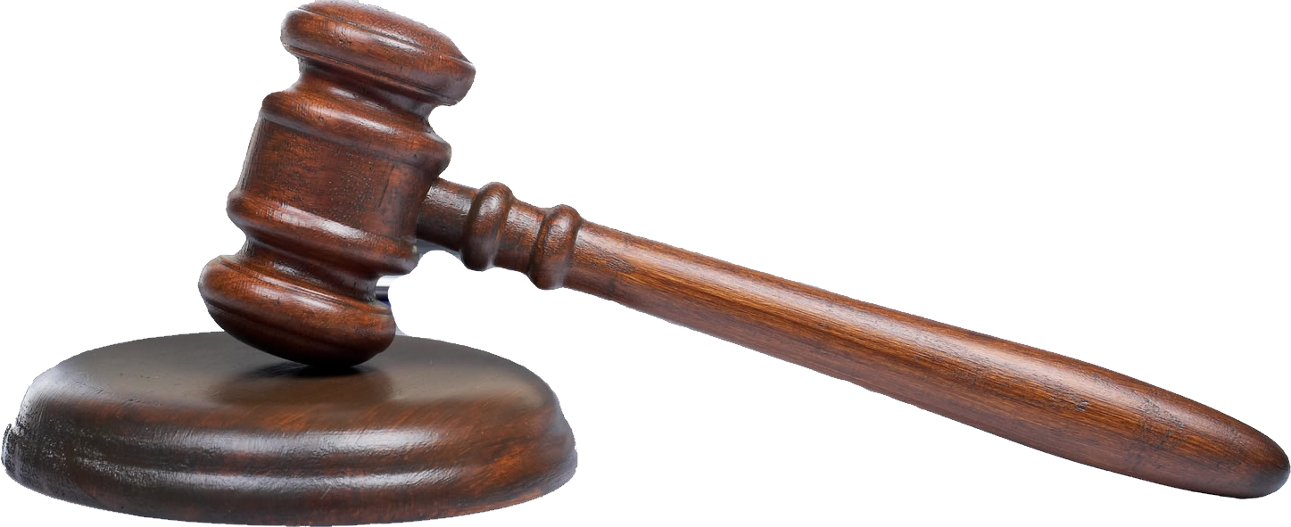
Mild-Mannered
Michael Oft (2000)
Action: porn → prostitution → stepdaughter
----> Rehab
Action: solicitation
----> Jail
Action: solicitation
----> Surgery
Action: porn
----> Surgery
...WHAT DO WE DO WITH THIS?

Slide 17
Caution in Neurocriminology
CSI Effect: ways in which the exaggerated portrayal of forensic science on crime TV shows influences the ways crime/law is seen
Brain Overclaim Syndrome: when neuroscience overshadows law and all responsibility is put on the brain rather than the individual
The end of responsibility
“Even if his amygdala made him more angry and volatile, since when are anger and volatility excusing conditions?” Morse asks. “Some people are angry because they had bad mommies and daddies and others because their amygdalas are mucked up. The question is: When should anger be an excusing condition?” (NYT Article)
Can sometimes make assumptions about causation
‘My brain made me do it!’
Was this man responsible for his crimes? What extent should we use neuroscience to hold people vs. their brains responsible for their crimes?
Notes:
first, that jurors expect more forensic evidence than is available or necessary, resulting in a higher rate of acquittal when such evidence is absent; and second, that jurors have greater confidence in forensic and particularly DNA evidence than is warranted,^{[31]} resulting in a higher rate of conviction when such evidence is present
Morse cites the case of Charles Whitman, a man who, in 1966, killed his wife and his mother, then climbed up a tower at the University of Texas and shot and killed 13 more people before being shot by police officers. Whitman was discovered after an autopsy to have a tumor that was putting pressure on his amygdala.
“So what if there’s biological causation? Causation can’t be an excuse for someone who believes that responsibility is possible. Since all behavior is caused, this would mean all behavior has to be excused.”

Slide 18
Caution in Neurocriminology Cont.
Using technology to predict criminal behavior
Neuroscience can place individuals in jeopardy for crimes they have not even committed yet
“This opens up a Pandora’s box in civilized society that I’m willing to fight against” - Helen S. Mayberg, a Professor of psychiatry, behavioral sciences and neurology at Emory University School of Medicine
What are the ethical and moral implications on using neuroscience to predict criminal offenses? Should we be doing this? Why or why not?
Lie Detection
New technology is much more intrusive -- bring up questions of self-incrimination and privacy
An intrusion of the freedom of thought → First amendment of freedom of expression
Should we be held accountable for what we do rather than what we think?
Screening judges for bias -- thoughts?
Free Will and Determinism
Does neurocriminology give more or less credit to the free will argument? Determinism?
What are some other cautions you all feel about this type of technology?
Notes:
first, that jurors expect more forensic evidence than is available or necessary, resulting in a higher rate of acquittal when such evidence is absent; and second, that jurors have greater confidence in forensic and particularly DNA evidence than is warranted,^{[31]} resulting in a higher rate of conviction when such evidence is present

