Slide 1
Language, Culture, & Music
By: Neha, Naveen, & Nick

Slide 2
Language
We are designed to walk… That we are taught to walk is impossible. And pretty much the same is true of language. Nobody is taught language. In fact, you can’t prevent the child from learning it. -Noam Chomsky

Slide 3
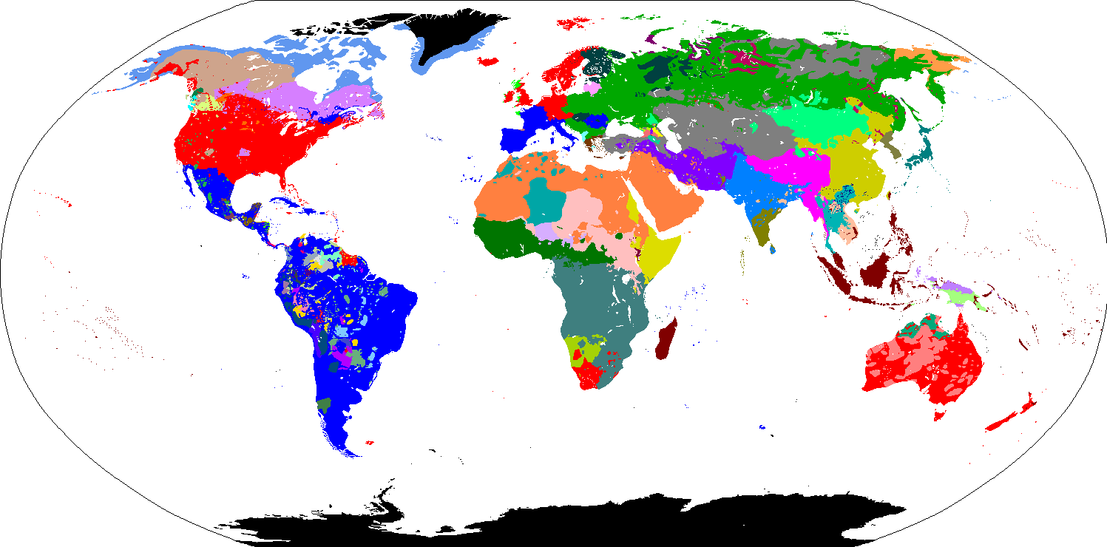
Language
Notes:
Start with hands up -
Language spoken
bilingual, tri lingual
At home or in school

Slide 4
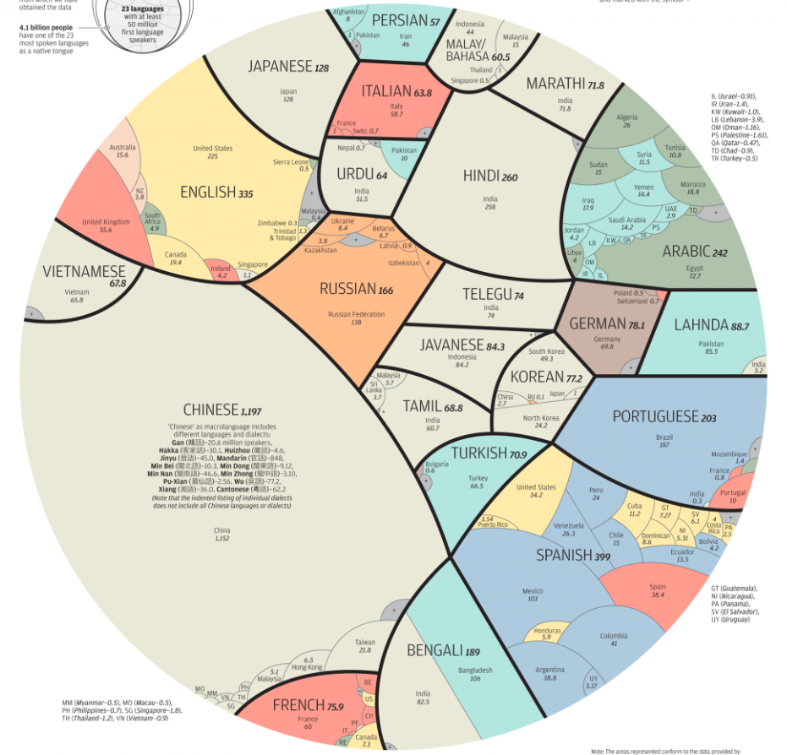
Language

Slide 5
First Language Acquisition
Every language is complex
Before the age of 5, the child knows most of the intricate system of grammar
Use of syntactic and semantic rules of the language
Join Sentences
Ask Questions
Use appropriate pronouns
How do children acquire such a complex system so quickly and effortlessly?
Do babies make a conscious decision to start learning a language?

Slide 6
Theories of First Language Acquisition
Nature vs. Nurture
Children learn language through imitation, reinforcement and analogy
Innateness hypothesis
Children are equipped with an innate template for language
Evidence
We end up knowing more about language than what we hear around us

Slide 7
First Language Acquisition Schedule
Most children follow the same milestones in acquiring language, in spite of different backgrounds, locations and upbringings
The biological schedule is related to the maturation of the infant’s brain to cope with the linguistic input
Young children acquire language by identifying the regularities in what is heard and applying that in what they say

Slide 8
Motherese Language
A type of simplified speech adopted by someone who spends time with the child
Simplified lexicon, phonological reduction, stressed intonation, simple sentences, lots of repetition

Slide 9
First Language Acquisition Schedule
Stage | Typical Age | Description
Cooing | 3-5 Months | Vowel-Like Sounds
Babbling | 6-10 Months | Repetitie CV Patterns
One-Word Stage | 12-18 Months | Single open-class word stems
Two-Word Stage | 18-20 Months | Mini-sentences with simple semantic relationships
Telegraphic Stage | 24-30 Months | Sentence structure emerge
Later multi- word Stage | 30+ Months | Grammatical structures emerge

Slide 10
Culture: “an amalgam of values, meanings, conventions and artifacts that constitute daily social realities.”

Slide 11
Cultural Neuroscience

Slide 12
Related Research
Implications of brain plasticity:
larger hippocampus - a region that is intimately involved in spatial memory - of London taxi drivers
increased cortical density in the motor cortex of jugglers

Slide 13
Importance of Cultural Neuroscience
About 90% of fMRI studies have come from countries of Western origin (Chiao, 2009).
Most psychological studies have been conducted with Westerners, who only account for about 12% of the world population (Arnett, 2008).
Not related to how individuals are ‘hardwired’ but how individuals are ‘molded’.
Analogous situation to research studies and medications based on similar types of bodies, (e.g. preponderance of male research.)

Slide 14
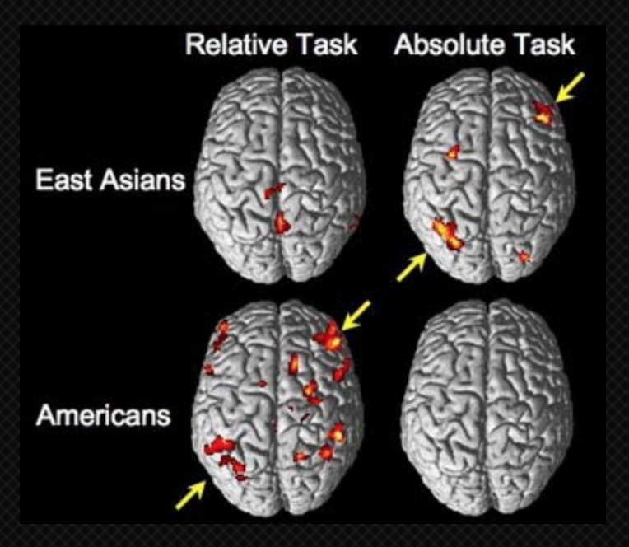
Self-construal Research

Slide 15
Discussion:
Implications for diverse working teams in the workplace and in research
Ethics of altering how schooling and parenting is conducted (optimization of a child)
Denoting some cultural effects as being ‘superior’ towards others

Slide 16
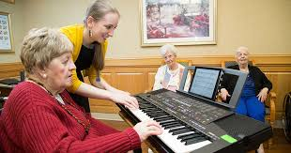
Music
How does music impact brain function and human behavior?
Can reduce stress, pain, symptoms of depression
Can improve cognitive and motor skills, spatial-temporal learning, and neurogenesis (brain’s ability to produce neurons)
People with Alzheimer’s and Parkinson’s respond positively to music
Watch video (4:30 - 9:30)
https://www.youtube.com/watch?v=MZFFwy5fwYI

Slide 17
Music
Adding on to everything else:
Adolescents’ choice of music and their reactions to/interpretations of it vary with age, culture, and ethnicity
Females - more likely to use music to reflect emotional state
Males - more likely to use music as a stimulant (energy or confidence)
Preference for certain types of music could be correlated with certain behaviors
Example: heavy metal is associated with increased depression, delinquency, men who listened to misogynistic lyrics → increased aggressive responses

Slide 18
Parts of the Brain Affected
Frontal Lobe - thinking, decision-making, planning
Enhanced w/ Music
Temporal Lobe - processes what we hear
Use this to appreciate music, language/words are interpreted in left hemisphere, music/sounds are interpreted in right hemisphere
Broca’s Area
Used to express music, playing an instrument might improve ability to communicate
Wernicke’s Area - comprehends written/spoken language
Used to analyze music
Occipital Lobe- processes what we see
Professional musicians use occipital cortex (visual cortex) when they listen to music while normal people use the temporal lobe (auditory/language center)
This suggests that musicians might visualize a music score when they are listening to music

Slide 19
Parts of the Brain Affected
Cerebellum - coordinates movement + stores physical memory
People who have memory loss/Alzheimer’s can’t recognize family but can remember to play music because muscle memory
Nucleus Accumbens - seeks pleasure + reward
Increases dopamine in nucleus accumbens, similar to cocaine
Amygdala - emotions
Can control fear, activate fight or flight
Hippocampus - memory, navigation
May increase neurogenesis in the hippocampus → new neurons + memory
Hypothalamus
Corpus Callosum
Putamen

Slide 20
Music Therapy
What is it?
Clinical and evidence-based use of music interventions to accomplish individualized goals or address physical, emotional, cognitive, and social needs (grief, anxiety, depression, after a stroke/traumatic head injury, Parkinson’s/Alzheimer’s)
Forms of treatment can include:
Creating music
Singing/listening music
Moving to music
Guided imagery
Playing instruments
Two kinds of processes that can be used
Creative - creating/producing music (engagement)
Receptive - music listening experiences (relaxation)
Does it work?
A growing field
A sense of empowerment

Slide 21
Questions relevant to us!
Is studying with music a benefit or drawback?
Benefits
soothing/relaxing music can help with stress/anxiety
Can improve focus on task by providing motivation and improving mood
Can improve endurance
Helps with memorization (positive mood → memory formation)
Drawbacks
Can be distracting
Music with lyrics while reading/writing → less efficient, absorbed less information
loud/agitated music can make reading comprehension hard
Students who use music to help memorize have a hard time recalling in test-taking environment

Slide 22
Discussion Questions
Since music has such a pervasive role in today’s popular culture and can influence our brains/behavior, do you think it should be regulated in schools, other institutions, etc.?
In your personal experience, what are the ways in which music (listening, playing, etc.) has shaped parts of you?
Do you think music is an innate gift or a nurtured talent?
Why do you think we’ve evolved to love/respect music?
Mate Selection
To Keep in Synch
To identify with tribe
To feel emotions
To intimidate predators

