Slide 1
Altered States:
Meditation & Psychoactive Drugs

Slide 2
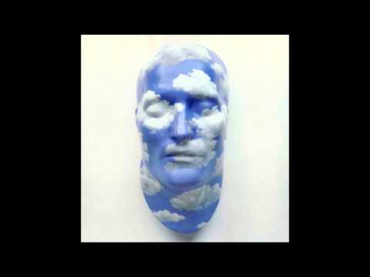
Guided Meditation

Slide 3
Meditation (n.): A practice where an individual uses a technique to train attention and awareness, and achieve a mentally clear and emotionally calm and stable state.

Slide 4
Focused Meditation

Slide 5
Open Monitoring Meditation

Slide 6
FA & OM Meditation

Slide 7
No Thought

Slide 8
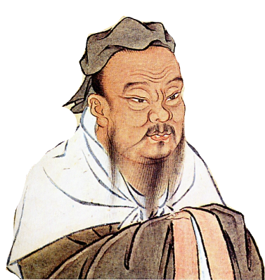

Slide 9
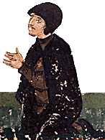
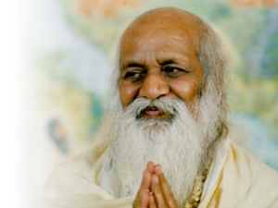

Slide 11
Should meditation be practiced within a school system?
Is meditation a commercial exploitation of a practice with ancient religious and cultural significance, or a respectful modernization of ancient techniques used to effectively promote wellness?
“Know well what leads you forward, and what holds you back”:
Do you intend to incorporate meditation into your life?

Slide 12
Cannabis

Slide 13
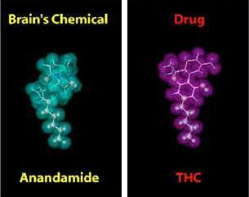
Science
THC’s chemical structure is similar to the brain chemical anandamide.
Similarity in structure allows the body to recognize THC and to alter normal brain communication.

Slide 14
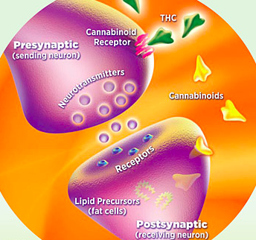
Endogenous cannabinoids function as neurotransmitters because they send chemical messages between nerve cells (neurons) throughout the nervous system.
The neural communication network that uses these cannabinoid neurotransmitters is known as the endocannabinoid system

Slide 15
Effects
They affect brain areas that influence pleasure, memory, thinking, concentration, movement, coordination, and sensory and time perception.
Notes:
long term
non addictive
majority believed less harmful than alcohol
gateway drug
lower quality of life

Slide 16
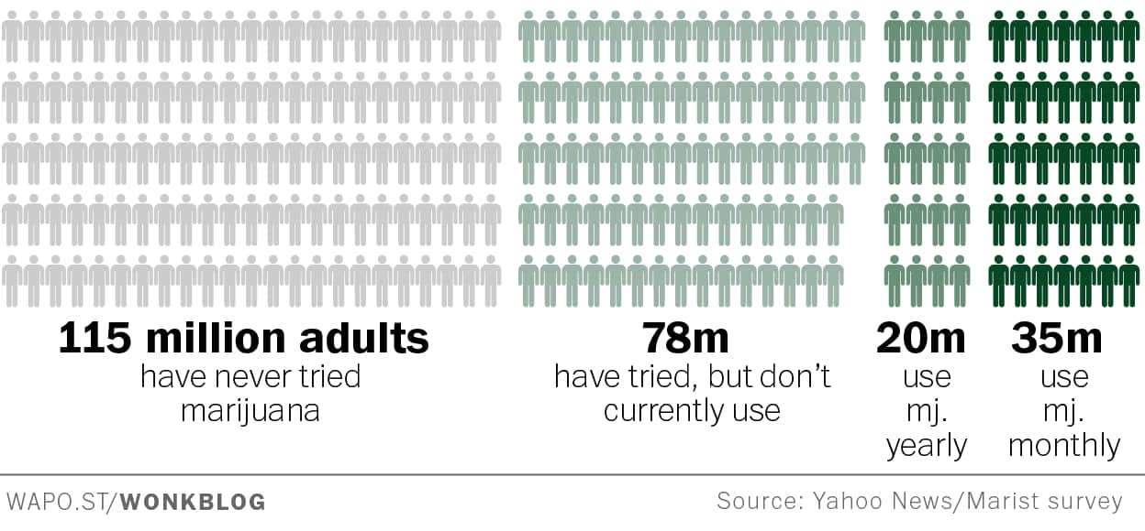
24 million Americans, or 8.9 percent of the population, were current marijuana users
Use
Notes:
perception

Slide 17
Legal Status
Since the beginning of the 20th century, most countries have enacted laws against the cultivation, possession or transfer of cannabis.
In December 2012, the U.S. state of Washington became the first state to officially legalize cannabis in a state law
In December 2013, Uruguay became the first country to legalize growing, sale and use of cannabis.
Discussion
Criminalization?
Medical Marajuana?
Recreational Use?
Notes:
In 1937, the “Marihuana Tax Act” was passed.

Slide 18
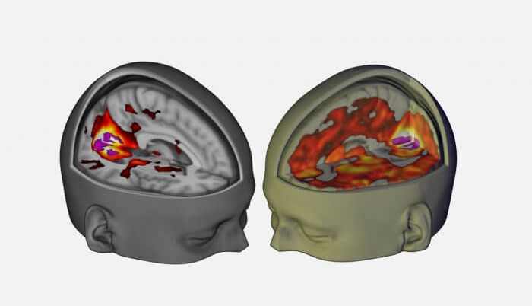
LSD
Notes:
In 1997, 13.6% of seniors had experimented with LSD at least once in their lives.
A study released in January 2008 found that about 3.1 million people in the US aged 12 to 25 said they had used LSD.

Slide 19
About
LSD, or lysergic acid diethylamide, is a psychedelic drug derived from a chemical in rye fungus. In 1938, Albert Hofmann, a Swiss scientist, synthesized LSD in his laboratory in Zurich, Switzerland. He unexpectedly discovered its hallucinogenic effects in 1943.

Slide 20
LSD acts on with a number of different receptors in the brain, including ones for the chemicals serotonin and dopamine, but it’s not known exactly which receptors are responsible for its various effects.
Daniel Wacker and his colleagues at the University of North Carolina, Chapel Hill, used crystallography to look at the structure of LSD when it binds to a receptor in the brain that normally detects serotonin. They discovered that part of this serotonin 2B receptor acts as a lid, closing around the LSD molecule and trapping it.

Slide 21
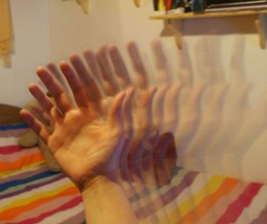
Visual Effects
Enhancement of Color
“Flowing”
Tracers

Slide 22
Simulation

Slide 24
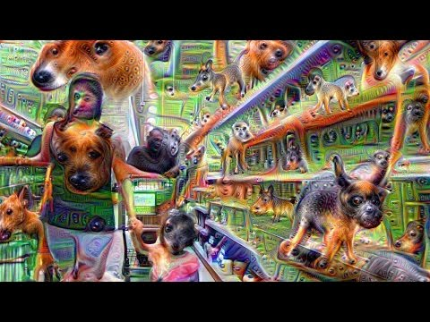

Slide 25
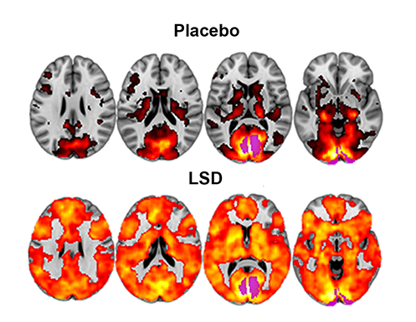
fMRI and magnetoencepha-
lography (MEG)
This image shows how, with eyes-closed, much more of the brain contributes to the visual experience under LSD than under placebo. The magnitude of this effect correlated with participants reports of complex, dreamlike visions
Notes:
fMRI and magnetoencephalography (MEG)

Slide 26
LSD typically changes the way people feel about themselves, other people, and the world, and this can happen in positive or negative ways.
How a given individual will be affected is extremely unpredictable.
Some of the most dramatic effects of LSD reported by researchers in smaller or case studies include:
Dramatic changes in sensations and feelings.
Feeling several different emotions at once.
Swing rapidly from one emotion to another.
Altered sense of time.
Altered sense of self.
Crossover senses, synesthesia (hearing colors, seeing sound)
Mental Effects

Slide 27
“As I was walking and experiencing every sound of the music and all the beautiful colors everywhere (I didn't see any colors that didn't exist, just that it all was extremely magnified.) It felt like my vision had become ultra HD and I could even zoom in wherever I wanted by just really focusing.”
And I start moving my tongue and since all my senses were so heightened and the power of the imagination it felt as if I accidentally swallowed my own tongue! I freak out wondering if I can still talk and I could but it felt weird. I scared and pull out my tongue to see if I still have it, I do but as I touch it it feels like I'm losing grip over it and like it's twisting and falling out.
Like being nothing and everything all at once. Like you're an infinitely small and insignificant being, that is infinitely large and important by virtue of being connected to, and part of, everything else.

Slide 28
War on Drugs

Slide 29
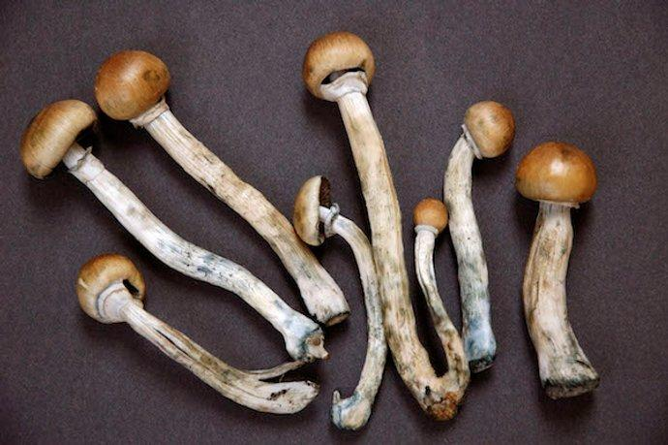
Psilocybin

Slide 30
Psilocybin
Psilocybin is the principal psychoactive component in the Psilocybe (silossbee) genus of mushrooms
“Magic mushrooms” are abundant on every continent (aside from Antarctica)
Thought to have been used in Latin American rituals (among other places) for thousands of years
At low doses, can cause visual enhancements, uncomfortable-to-pleasurable bodily sensations, psychotic thoughts, and enlightening experiences
Contain non-toxic, non-addictive psychoactive compounds closely related to serotonin
No cases in literature of overdose resulting in death from ingesting psilocybin mushrooms
LD50 (the amount of a toxic agent that is sufficient to kill 50 percent of a population of animals usually within a certain time) is estimated to be 6,000 mg. Average psychedelic dose for humans is 6mg.
Can bring out early symptoms of mental disorder in genetically predisposed individuals

Slide 31
Psilocybin
Classified as Schedule I (high addiction potential and no medicinal value)
Potential to alleviate depression, cure drug addiction, and ease the emotional suffering of terminally-ill cancer patients
In 2011 JHSM pilot study, psilocybin was administered to 15 volunteers to see if it would aid in smoking cessation. 80% of participants stopped smoking for at least 6 months after the study (generally rate is 15-30%).
In 2010 JHSM study, 12 terminally-ill cancer patients were administered psilocybin to see if it would ease their end-of-life suffering. After treatment, patients reported significantly less anxiety and depression.

Slide 32
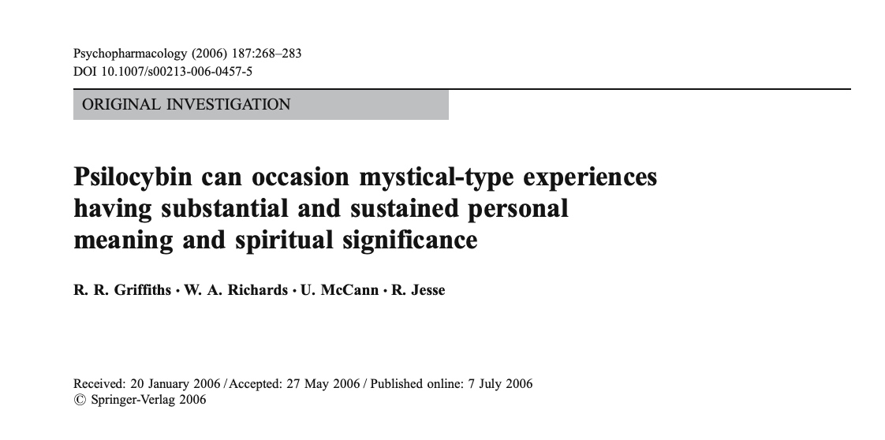
Dr. Roland Griffiths

Slide 33
Dr. Roland Griffiths
Conducting research on mood-altering drugs for past 40 years, started practicing meditation 20 years ago
Recently saw research on mystical experiences in 50s and 60s, showing that under some conditions, classic hallucinogens like psilocybin could occasion mystical experiences that closely resemble those that occur naturally and have been reported by mystics throughout history
Psychedelic research had been blocked for decades--Griffiths obtained approval
“The most beautiful and profound emotion we can experience is the sensation of the mystical. It is the source of all true science.” - Einstein
His research demonstrates that, under supported conditions, psilocybin can occasion mystical-type experiences associated with enduring positive changes in attitudes, mood and behavior

Slide 34
Johns Hopkins Psilocybin Research Project
245 participants in over 600 sessions
In its 18th year, has examined effects of psilocybin on healthy volunteers, smokers, cancer patients and long-term meditators
Conducted 3 double-blind studies on healthy volunteers
Volunteers develop trusting relationship with session monitors, come to comfortable room, swallow capsule, lay on couch, use eye mask and headphones with music, direct attention inward. Monitors reassure if fear or anxiety arise.
High dose produces hallucinogenic effects, and great increases in reported mystical experiences for most (sense of encountering ultimate reality). At end of session, effects are gone but memories endure (1 month after, 80% of volunteers who received 1-2 high doses reported that the experience was among the 5 most personally meaningful experiences of their lives, 50% reported it being the single-most.) Positive effects sustained for at least one year, probably longer.

Slide 35
DMT (N,N-Dimethyltryptamine)

Slide 36
DMT (N,N-Dimethyltryptamine)
Psychoactive component of ayahuasca
Ayahuasca has been used for centuries by tribes in South America during spiritual ceremonies
Ayahuasca consists of Psychotria viridis leaves and Banisteriopsis caapi vines (neither have hallucinogenic power on their own)
Leaves contain DMT, which is structurally similar to serotonin (and psilocybin)--gut enzymes normally deactivate before it’s absorbed in bloodstream, but vines inhibit enzymes
Effects of brew begin at T30. Hallucinations peak at 1 hour and subside after 4-6 hours
In contrast to acid and mushroom trips, participants are fully aware that they’re visually hallucinating
Often used with desire of reconciling thoughts and emotions, rather than having a trip
Default Mode Network is area of brain whose overactivity is associated with depression, anxiety and social phobia
Ayahuasca causes significant decrease in activity (usually linked to meditative state)
May hold potential for cancer research
No tolerance, but usually physical reaction (vomit, etc.) since brew is acidic
Issue of drug tourism, fake shamans, etc.

Slide 37
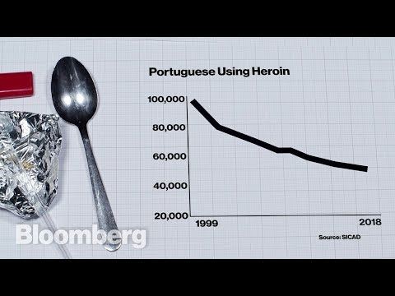
Portugal’s Drug Policy
Notes:
Roughly 1% of population addicted to heroin in the 1990s and highest rate of HIV infection in EU
First country to decriminalize consumption of all drugs in 2001

